Slide 1
ONLINE BOOK STORE
UNDER THE GUIDANCE OF
POOJA MEHTA
Submitted by
Yogesh G
Rajamanickam B
Martin
Supriya
Priyadharshini
Nayahi Fanisha

Slide 2
Introduction
Online Book Store is the process of creating a book and sold in website or other applications .Admin can able to insert a book according to book title, category, Author and after created it will added to the book list and after admin can able to sold the book in online. Online book store provides the facilities of maintaining the details of book. So if admin needs any details about the particular book admin can able to get by using search by book title or category.

Slide 3
Project Objectives
Admin can able to sold the book in online instead of selling in book shop or conducting any book exhibition.
Admin can easily able to get the status of book by using search of particular book details and it reduces the time for searching the book
This project is totally build at administrative end and thus only the admin can able to access.

Slide 4
Software Specification
Technology :JAVA
Business layer :Spring Boot, Spring Framework, RestAPI,JPA and Hibernate
Database :MySQL
Web server :Tomcat Server
Source code editor :Visual Studio Code

Slide 5
Hardware Specification
Intel I3 7th Gen
8GB RAM
512kb Cache Memory
512 SSD Hard Disk

Slide 6
UML Diagram
Use Case Diagram
login
adding book
Book by category
Database
Book by author
Admin
Book by title
Sale by book
logout

Slide 7
UML Diagram
Class Diagram
Book
Id ()
Author ()
Category ()
Price ()
Database
Adding book
Admin

Slide 8
Connection Between Angular And Spring Boot
Angular
Templates
Components
Services
HTTP Client
Spring Boot
Spring REST Controller
MySQL
Database
Services
Model
Spring Data JPA

Slide 9
Spring Framework
The Spring Framework (Spring) Is An Open-source Application Framework That Provides Infrastructure Support For Developing Java Applications. One Of The Most Popular Java Enterprise Edition (Java EE) Frameworks, Spring Helps Developers Create High Performing Applications Using Plain Old Java Objects (Pojos).
Although The Spring Framework Does Not Have Any Specific Programming Model, It Has Become Popular Among Java Developers As An Addition To The Java Platform. It Has A Huge Community Of Java Developers Who Are Working And Contributing To Introducing More Extensions And Improving Existing Features Offered By The Spring Framework.

Slide 10
Spring Annotations
@Controller :@Controller Annotation Indicates That A Particular Class Serves The Role Of A Controller. Spring Controller Annotation Is Typically Used In Combination With Annotated Handler Methods Based On The @Requestmapping.
@Restcontroller :@Restcontroller Annotation In Order To Simplify The Creation Of Restful Web Services. It's A Convenient Annotation That Combines @Controller And @Responsebody.
@Autowired: @Autowired Annotation Is Used For Automatic Dependency Injection. Spring Framework Is Built On Dependency Injection And We Inject The Class Dependencies Through Spring Bean Configuration File.
@Entitty : @Entity Represents A Table In A Relational Database, And Each Entity Instance Corresponds To A Row In That Table.

Slide 11
@Requestmapping :@Requestmapping Annotation Is Used To Map Web Requests Onto Specific Handler Classes And/or Handler Methods And Can Be Applied To The Controller Class As Well As Methods.
@Repository: @Repository Annotation Is Used To Indicate That The Class Provides The Mechanism For Storage, Retrieval, Search, Update And Delete Operation On Objects.
@Service:@service Annotation And Allows Developers To Add Business Functionalities. The Annotation Is Used With The Classes That Provide These Business Functionalities.
@Table Annotation Allows You To Specify The Details Of The Table That Will Be Used To Persist The Entity In The Database.

Slide 12
@Join Column:@joinumn Apponation Is Used Tospecify A Column For Joining An Entity Assosation Or Element Collection
@Getmaping :@Getmapping Annotations Is Used To Read All The Records
@Postmapping:@postmapping Annotations It Is Used To Add The Record.
@Putmapping:@putmapping Annotations It Is Used To Update The Records.
@Deletemapping:@deletemapping Annotation Is Used To Delete The Records.
@Pathvariable:@pathvariable Annotation Is Used To Extract The Value Of The Template Variables And Assign Their Value To A Method Variable.
@Param:@param Is Used To Denote A Description Of The Parameter A Method Can Receive.

Slide 13
MySQL Database
MySQL is a Relational Database Management System (RDBMS) that offers a variety of features, including: It allows us to use tables, rows, columns, and indexes and to perform database operations on them. Tables (collection of rows and columns), also known as relations, are used to construct database relationships.

Slide 14
Angular
Angular is a development platform, built on TypeScript. As a platform, Angular includes:
A component-based framework for building scalable web applications.
A collection of well-integrated libraries that cover a wide variety of features, including routing, forms management, client-server communication, and more.
A suite of developer tools to help you develop, build, test, and update your code.

Slide 15
Components:
Components are the most basic UI building block of an Angular app. An Angular app contains a tree of Angular components.Angular components are a subset of directives, always associated with a template.
Components used in Angular
Home Home
About us Create
Contact us Search title
Login Search catagory
Search Author
Logout

Slide 16
Structure of the Components in Angular
Module.ts: This is the main module file for the project. Each Angular project is divided into modules to make the project management easy.
Component.html: This file is used to make changes to the page. You can edit this file as an HTML file.
Component.spec.ts: These are automatically generated files which contain unit tests for source component.

Slide 17
component.ts: it helps to do the processing of the html structure in the .ts file. the processing will include activities such as connecting to the database, interacting with other components, routing, services, etc.
component.css: here you can add css for your component.

Slide 18
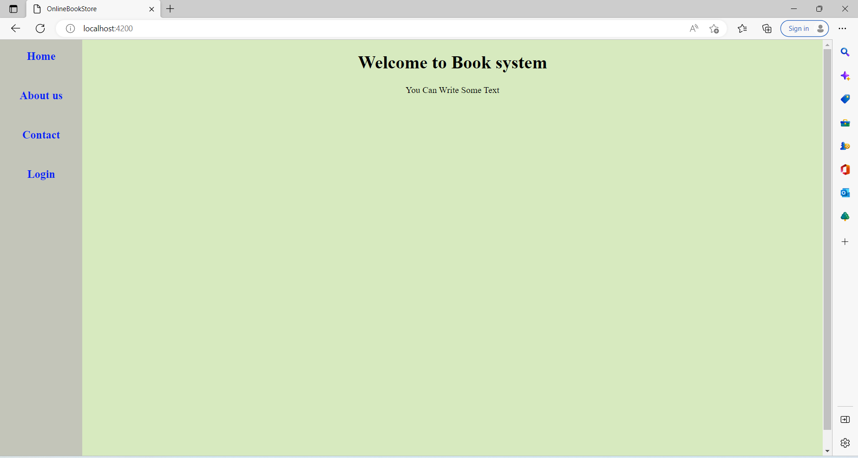
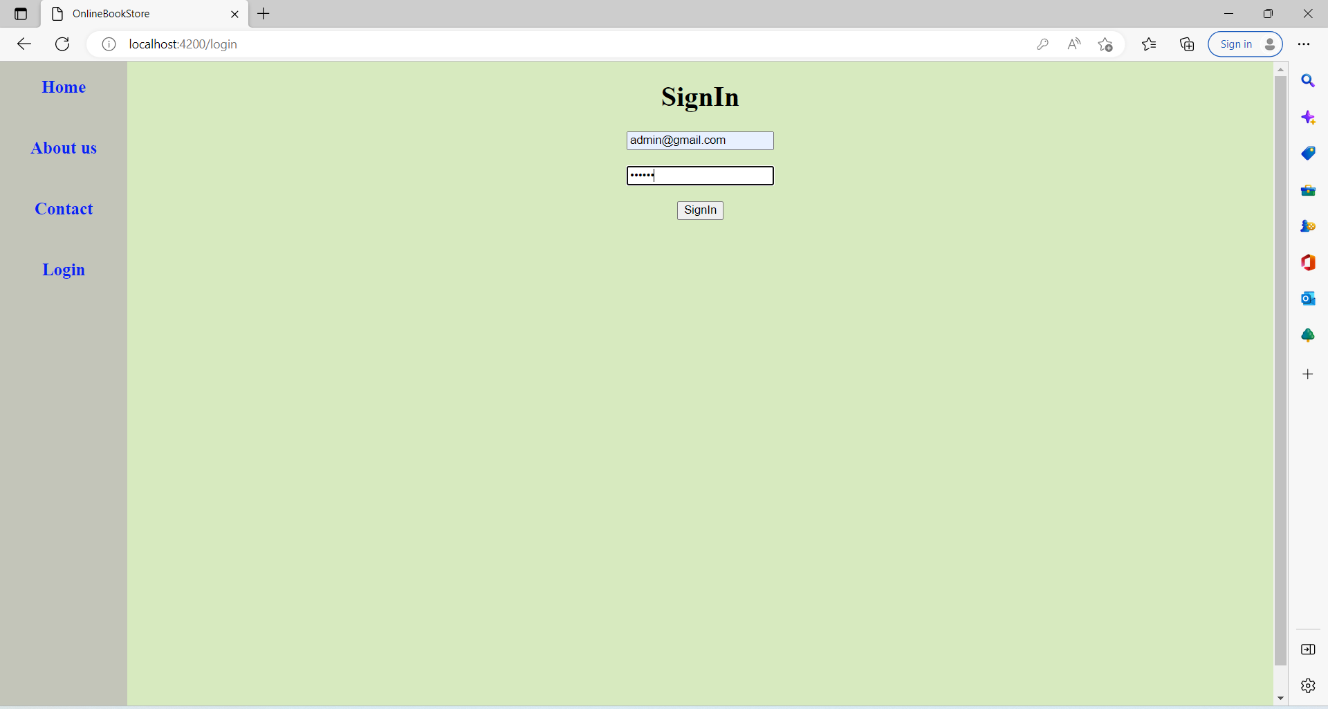
Output:

Slide 19
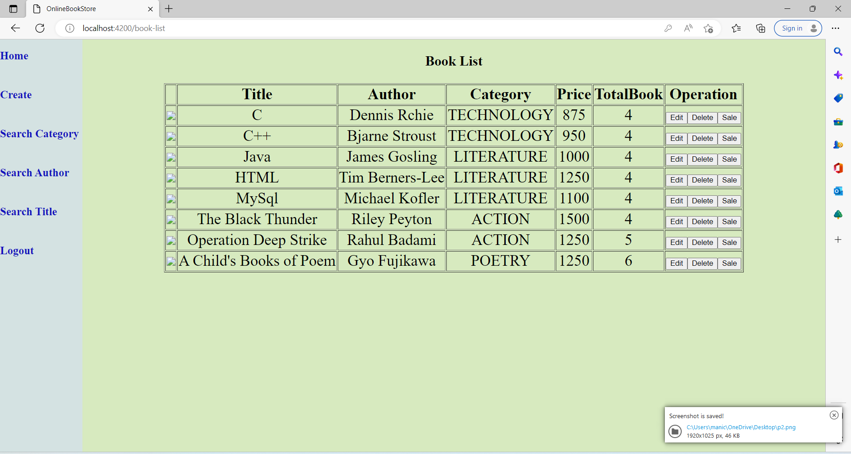
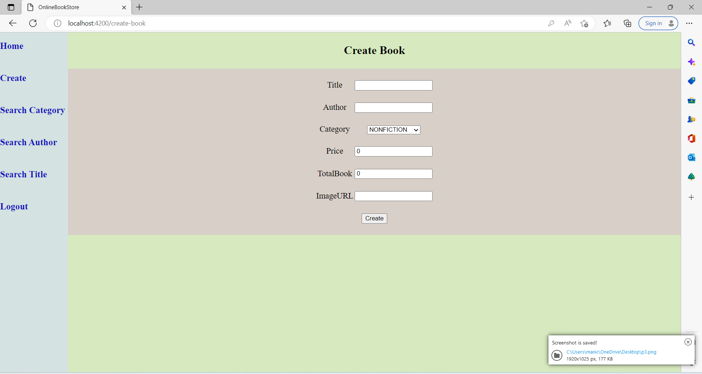

Slide 20
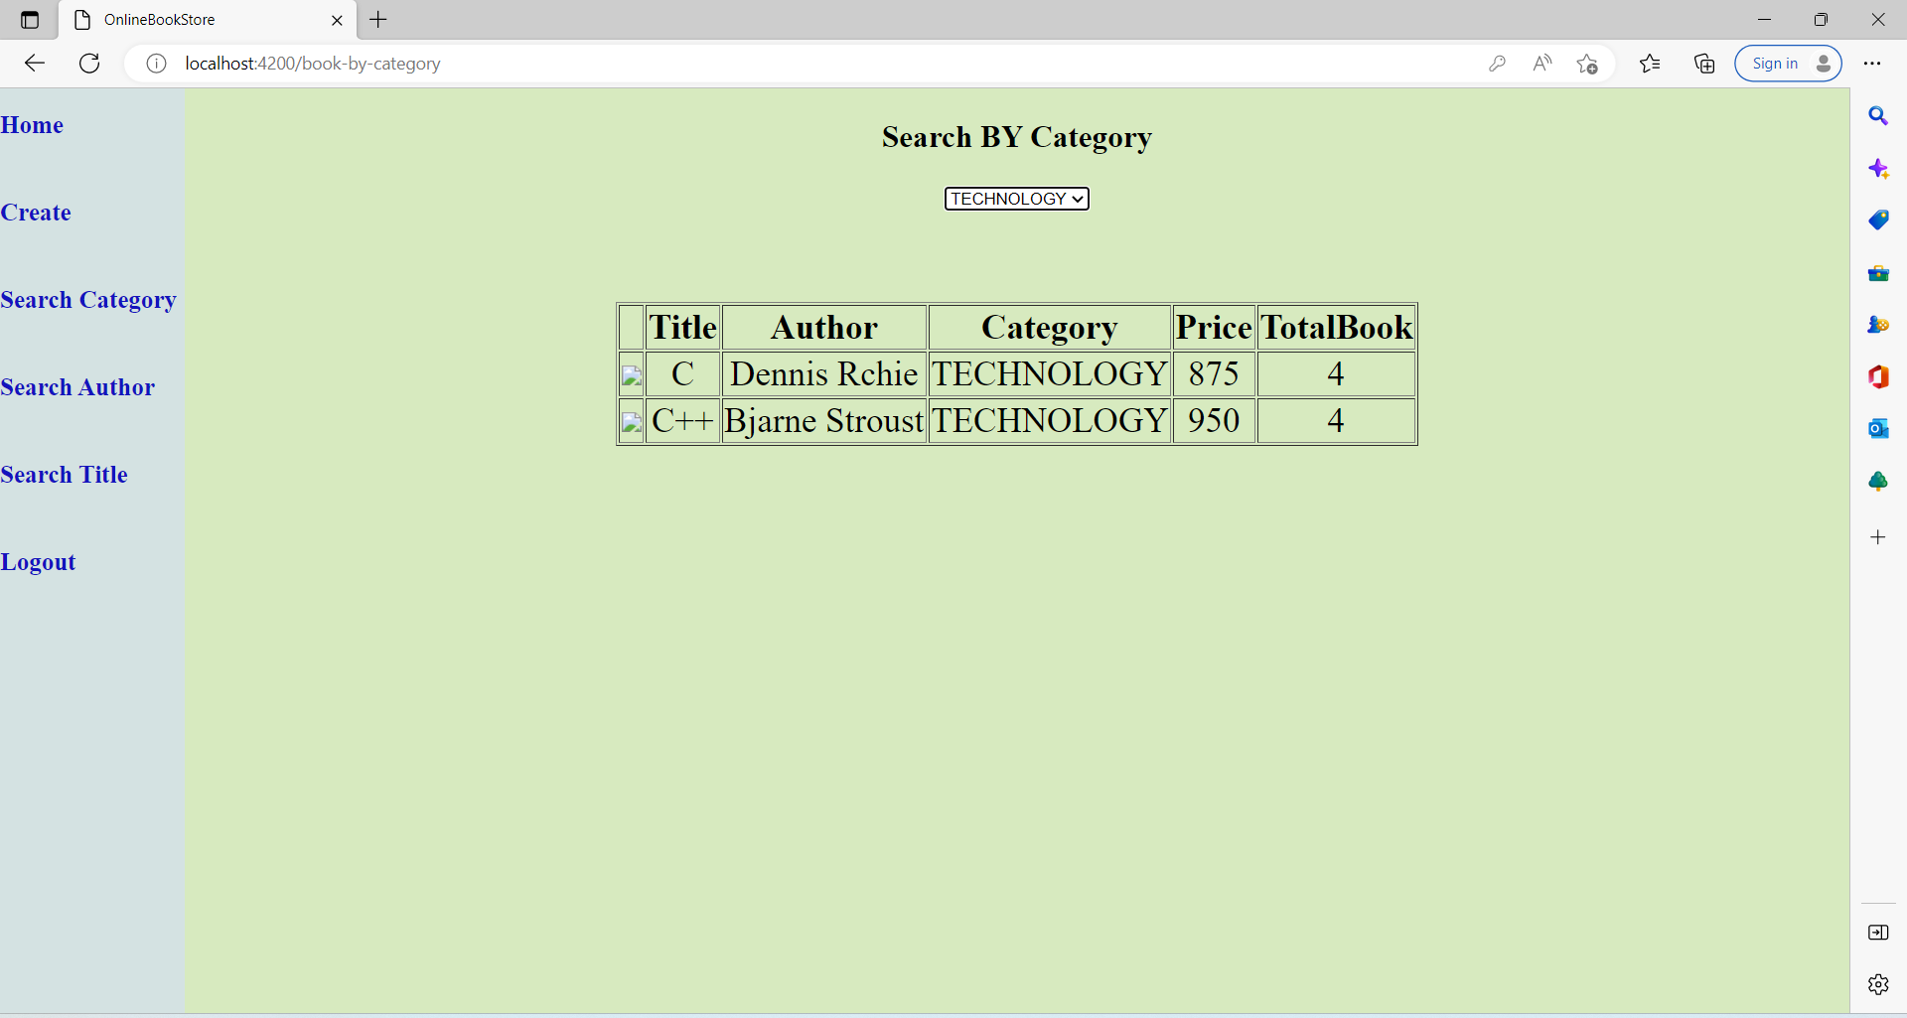
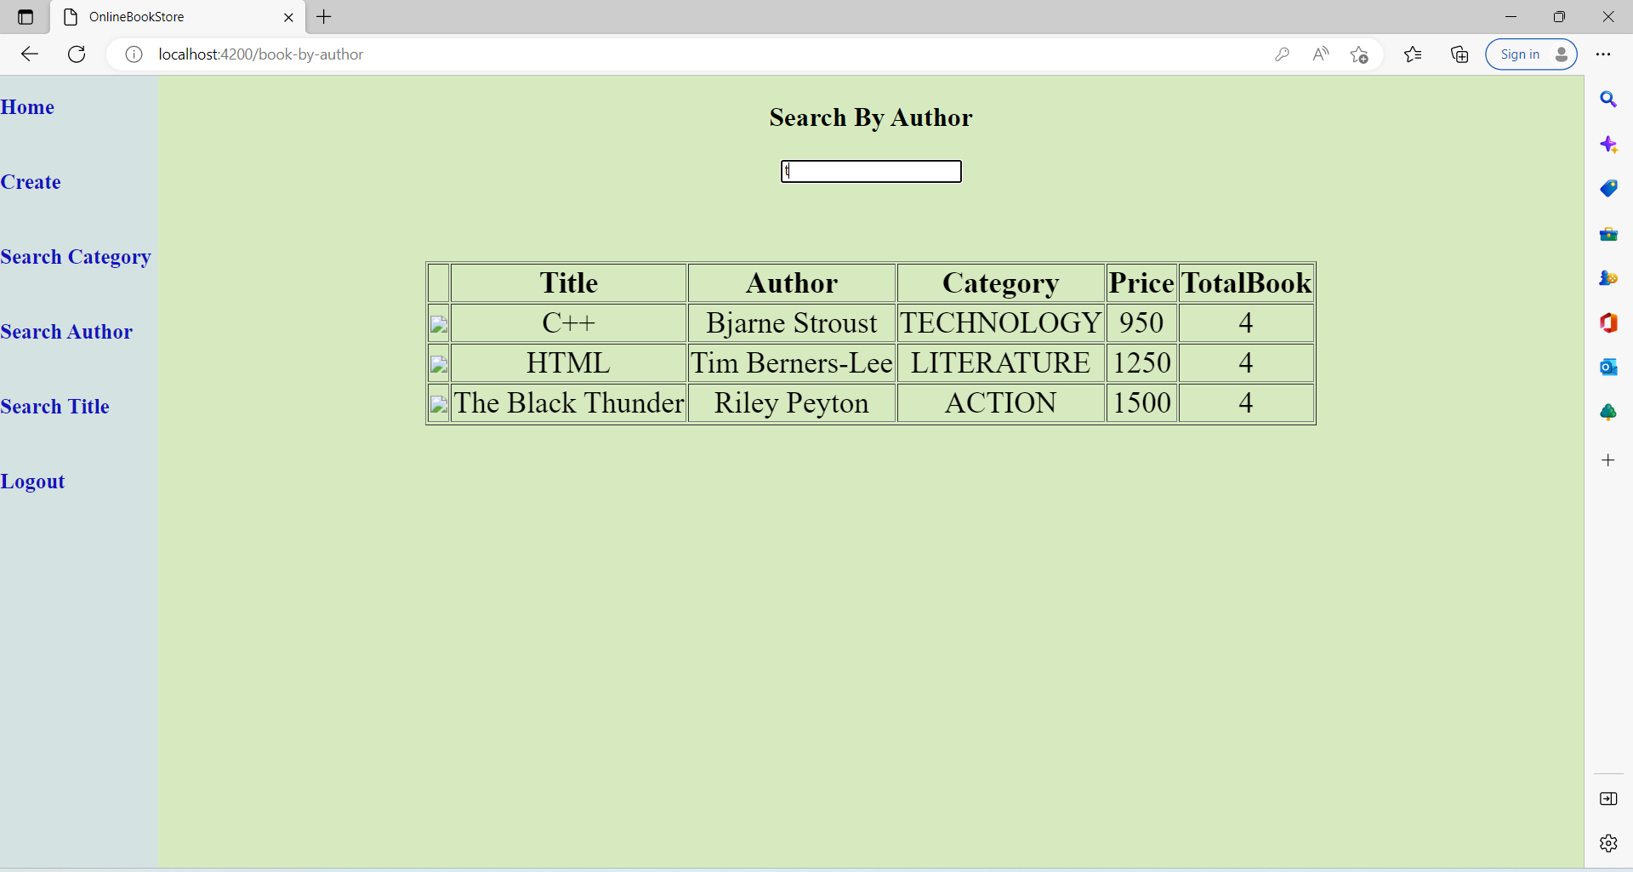

Slide 21
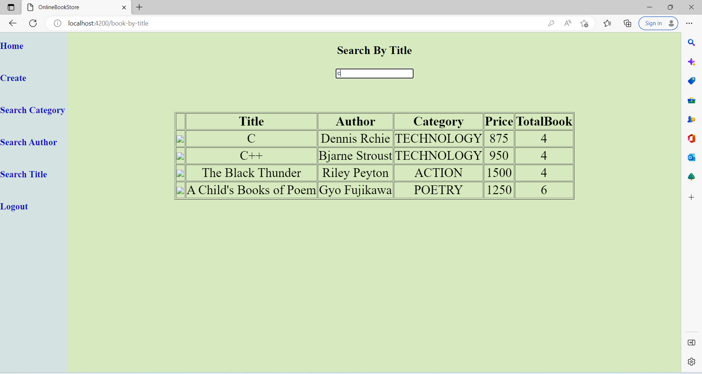
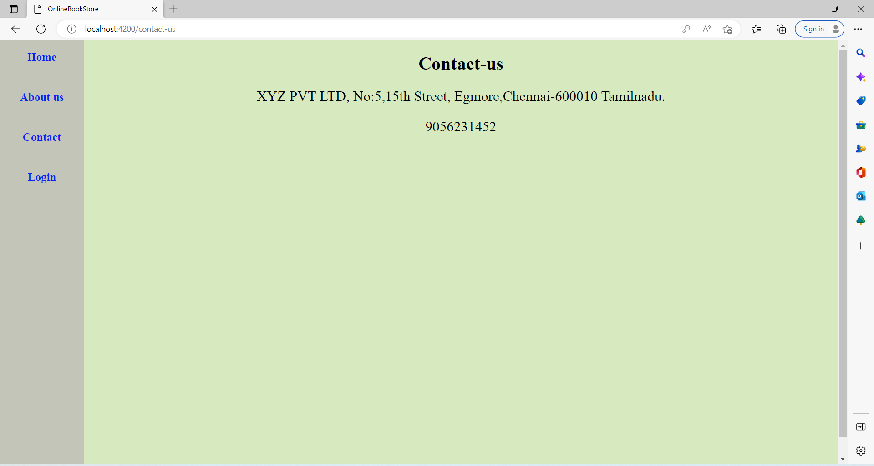

Slide 22
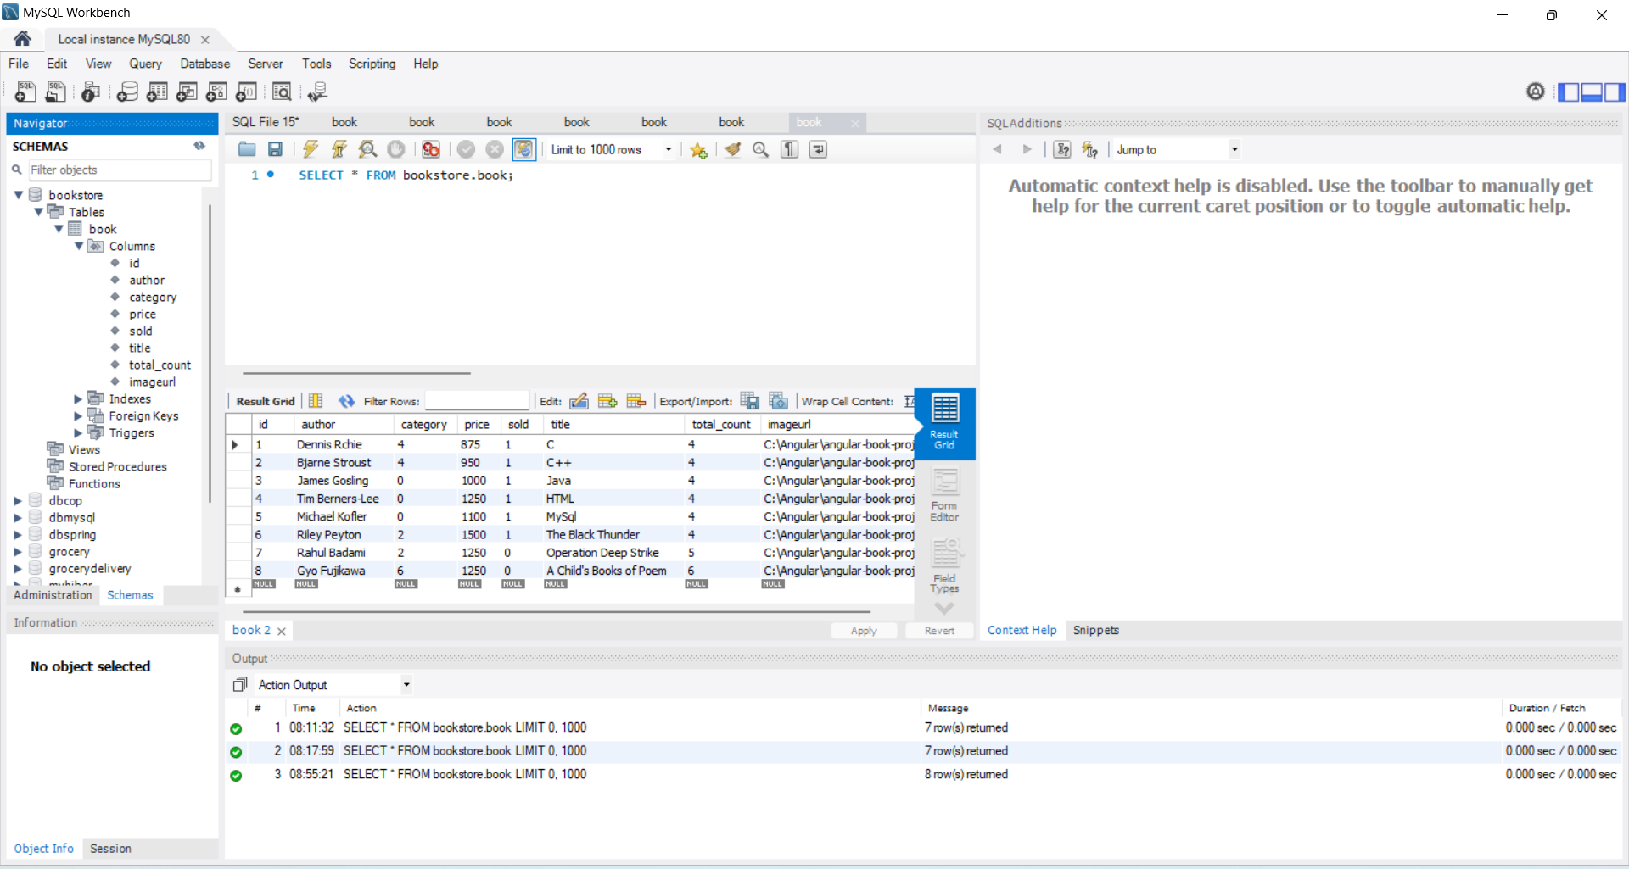
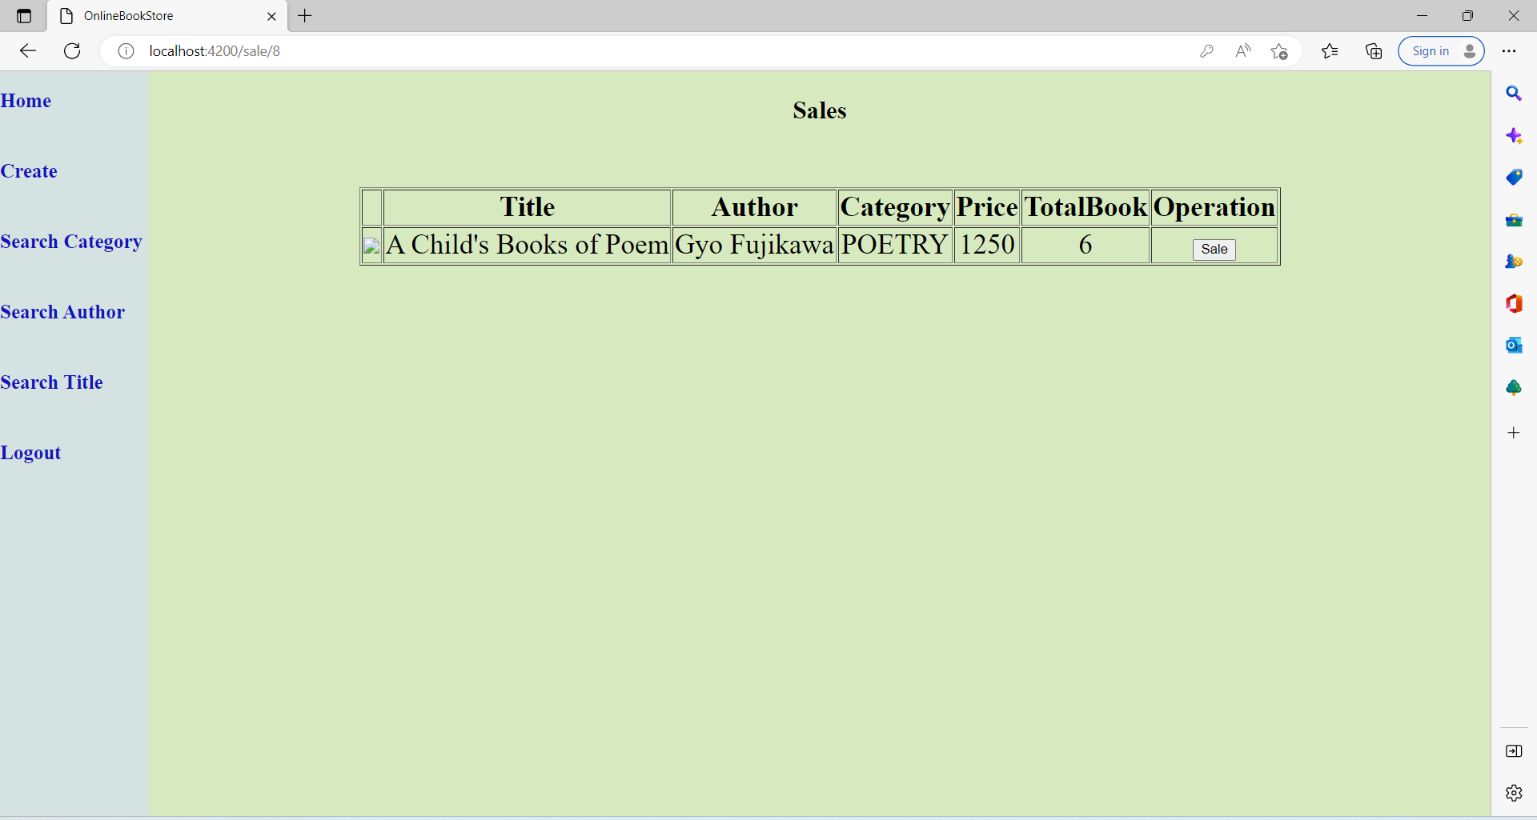

Slide 23
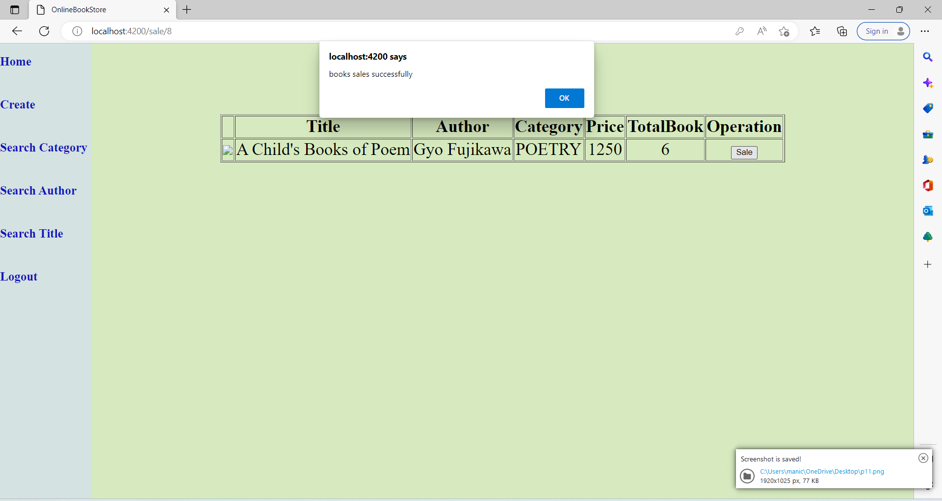

Slide 24
ADVANTAGE
You don't need a physical store
Save cost
Save time
Be Your own Boos
Keep your passion alive
Easy to operate
Less time required for searching of particular books

Slide 25
Conclusion
This online book store project is created based on spring boot, Angular,MySQL database
In this project is mainly done to save the admin time so that the admin can be able to sold the book in online
Admin can able to search the book, title, catagory and it makes easy to get and sold the particular book

Slide 26
THANK YOU

